Slide 1
Hospital Management System
HCL Technologies Ltd.
Presented By-
P.Gowthami (N151141),
S.Naga Mohini (N151136).

Slide 2
Contents :-
Introduction
Technologies used
Existing model
Proposed model
Demo
Future scope
Conclusion
References

Slide 3
Introduction
Hospital Management System is a software application designed to improve the quality and management of clinical care and hospital health care management in the areas of clinical process analysis and activity-based costing.Hospital Management System enables you to develop your organization and improve its effectiveness and quality of work
The Hospital Management System (HMS) core essence for the system is to register a patient info, to add/ save the Physician details, to search for Physician based on specified search criteria, Patient Diagnosis details and to View Patient History.
The HMS is designed using Spring MVC, Spring MVC allows you to avoid writing utility code to support your web application as it makes handling HTTP requests and responses easier.

Slide 4
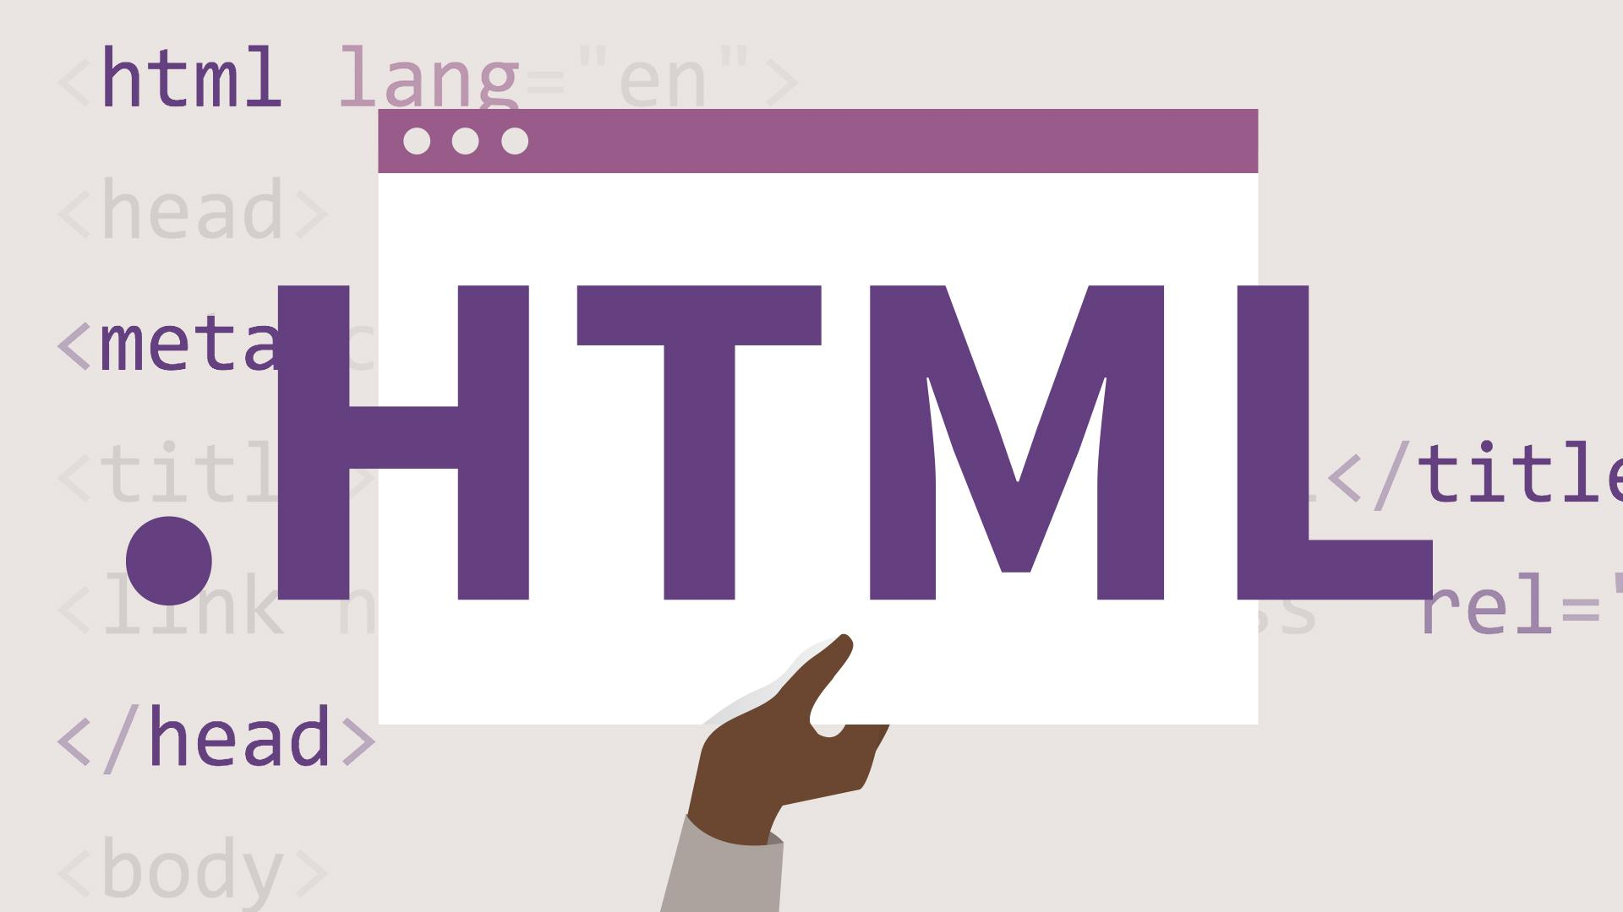





Technologies used in HMS

Slide 5
Existing model
Hospitals currently use a manual system for the management and
maintenance of critical information.
The current system requires numerous paper forms, with data stores
spread throughout the hospital management infrastructure.
Multiple copies of the same information exist in the hospital and may
lead to inconsistencies in data in various data stores.

Slide 6
Proposed Model
The Hospital Management System (HMS) is designed for Any Hospital to
replace their existing manual, paper based system.
The new system is to control the Patient and physician information.
These services are to be provided in an efficient, cost effective manner,
with the goal of reducing the time and resources currently required for
such tasks.

Slide 7
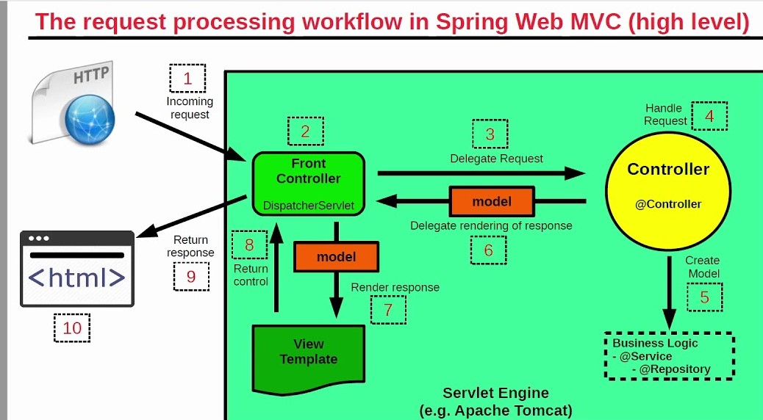
Spring Architecture

Slide 8
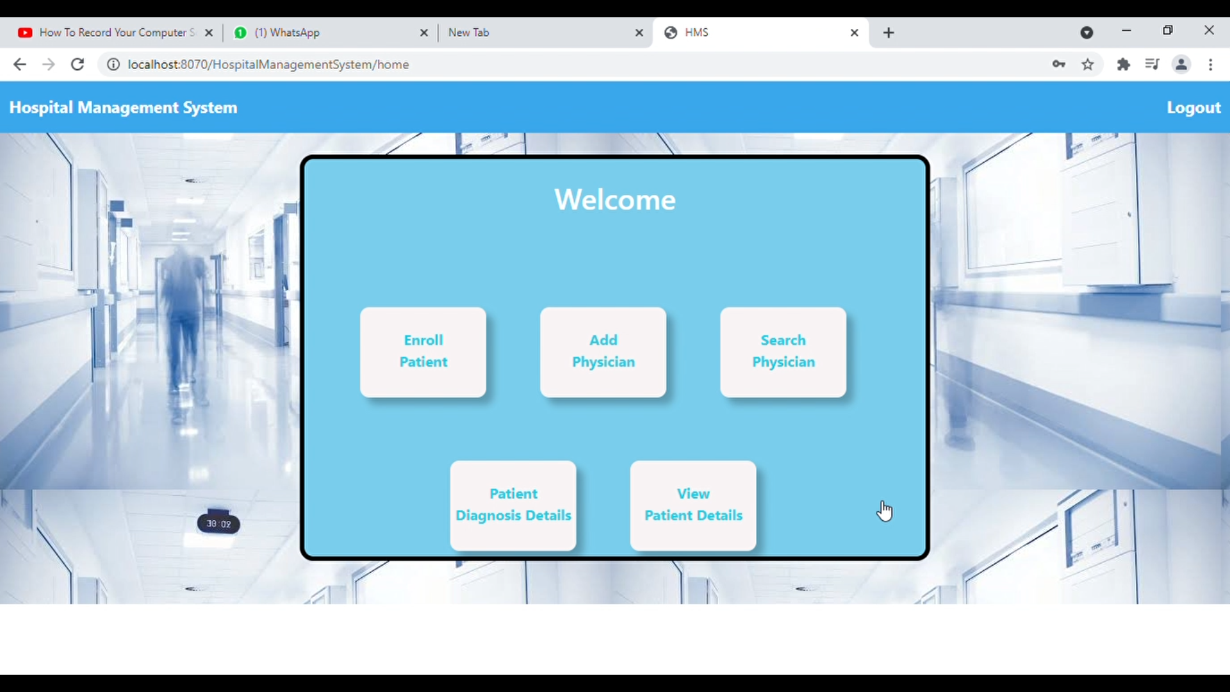
Demo

Slide 9
Future Scope
The next enhancement is, we will develop online services. That means, if a
patient has any problems he can send his problem to the doctor through the
internet from his home then the doctor will reply to him. In this patients have
some login name and password.

Slide 10
Conclusion
The package was designed in such a way that future modifications can be
done easily. The following conclusion can be deduced from the development
of the project.
=> It provides a friendly graphical user interface which proves to be better when compared to the existing system.
=> It effectively overcomes the delay in communications.
=> System security, data security and reliability are the striking features.

Slide 11
References
[1] spring architecture - Bing
[2] Spring MVC Step by Step Tutorial With Hibernate, MySQL, JSP Using Java Configurations | TutorialsPedia
[3] Spring - MVC Framework - Tutorialspoint
[4]RequestLifecycle.png (1196×798) (terasolunaorg.github.io)

Slide 12
Thank you

